Slide 1
Using Microsoft Speech Library
Under the direction of
DR \ Khaled Hussein.
Prepared by\
§-Mahmoud Mohamed Atia.

Slide 2
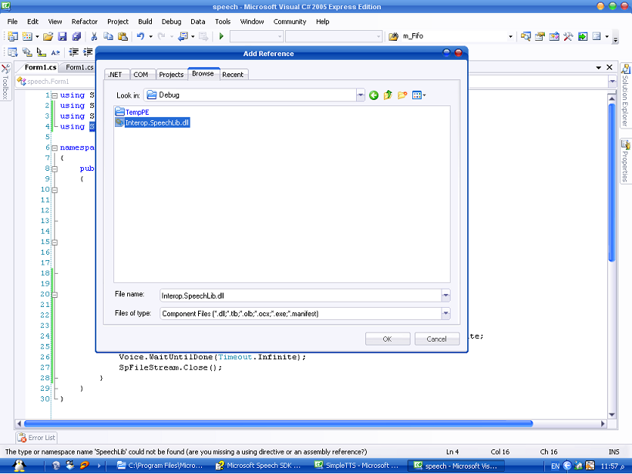
§-To run the program you must firstly add the reference
Interop.SpeechLib.dll you can find it in the path
C:\Program Files\Microsoft Speech SDK 5.1\Samples\CSharp\SimpleTTS\obj\Debug

Slide 3
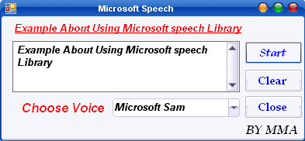
GUI
The Text that will convert
Speaker voice

Slide 4
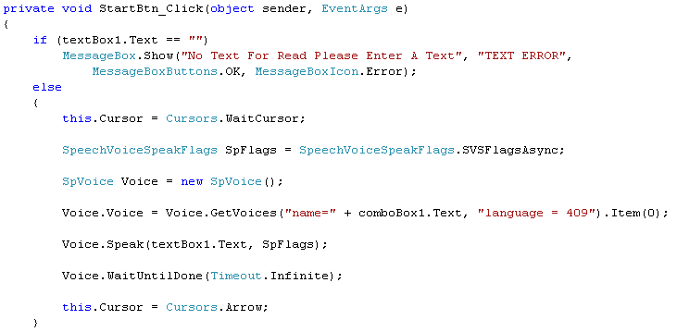
§-When clicking at Start Button

Slide 5
§-The program start to convert the text to
speech by
§-Determine the SpeechVoiceSpeakFlags
type

Slide 6
§- SpeechVoiceSpeakFlags types
SVSFlagsAsync
SVSFPurgeBeforeSpeak
SVSFIsFilename
SVSFIsXML
SVSFIsNotXML
Specifies that the Speak call should be asynchronous
Purges all pending speak requests prior to this speak call.
The string passed to the Speak method is a file name rather than text.
  The input text will be parsed for XML markup.
The input text will not be parsed for XML markup.

Slide 7
Global state changes in the XML markup will persist across speak calls.
SVSFPersistXML
SVSFNLPSpeakPunc
SVSFNLPMask
SVSFVoiceMask
SVSFUnusedFlags
Punctuation characters should be expanded into words (e.g. "This is it." would become "This is it period").
  Flags handled by SAPI (as opposed to the text-to-speech engine) are set in this mask.
This mask has every flag bit set.
  This mask has every unused bit set.

Slide 8
§- SpVoice object
§- Creating Voice object from class SpVoice
§-SpVoice is an automation object defines the types.
of events that can be received by an SpVoice object
from a text-to-speech (TTS) engine.

Slide 9
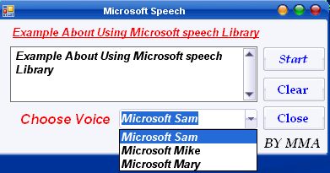
§- SpVoice object
§-Voice object used to change the speaker using
(GetVoices) method.
The code of US American English

Slide 10

§- SpVoice object
§- SpVoice as a client and TTS engine as a server.
§-Voice object send a request with (Speak) method.
§-(Speak) send text strings to the TTS engine.

Slide 11

§ Thanks 4 you §
§ THE END §

